Slide 1
Statistical Modelling for Prediction of Haemoglobin levels using Non-Invasive Spectrometry
Dhanashri Kanitkar
Hrishita Bapuram
Shraddha Kodavade
Mentors: Prof. Sarada Samantaray
Prof. Shubham Bhatt

Slide 2
Introduction
EzeRx, Objectives

Slide 3


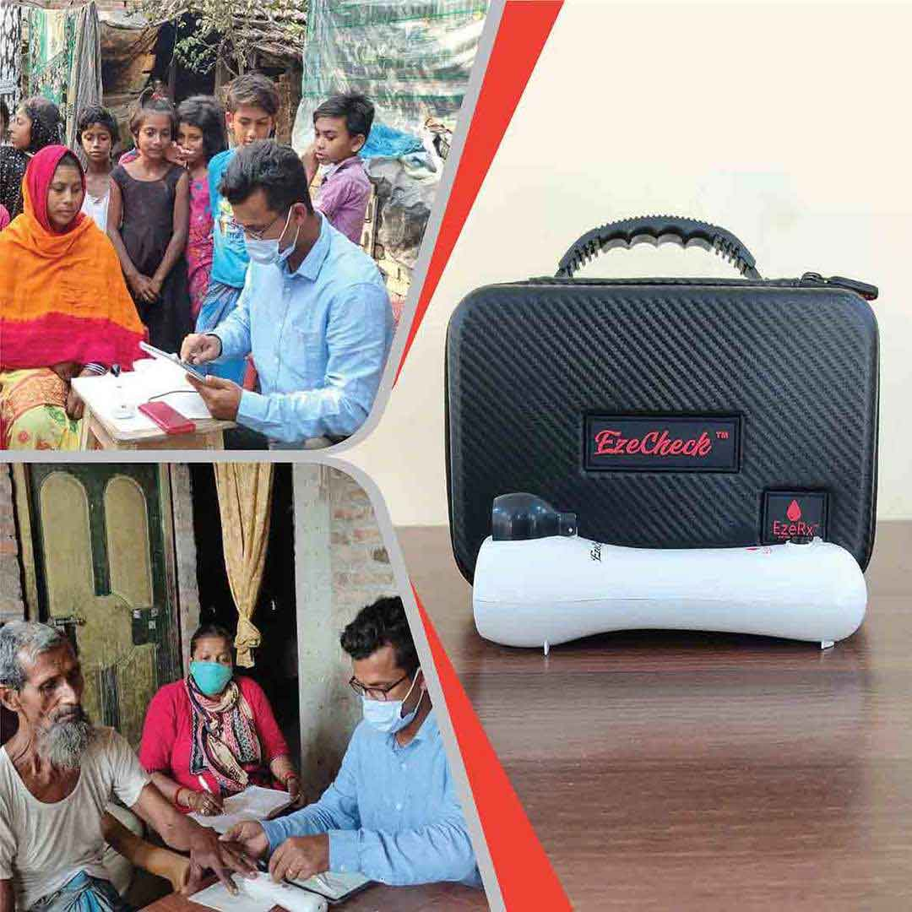
EzeRx is a Med-Tech & BioTech startup founded in 2018 which aims to develop highly progressive medical devices and innovative solutions.
To develop and manufacture innovative non-invasive medical devices and solutions that make screening hassle-free and enable regular check-ups for early detection of problems so that further treatment can take place, thus bridging the gap between diagnosis and treatment.
Partha Pratim Das Mahapatra
Founder & CEO

Slide 4
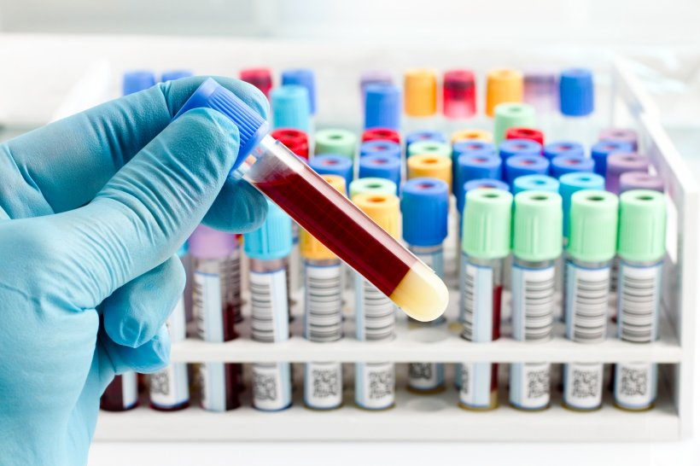
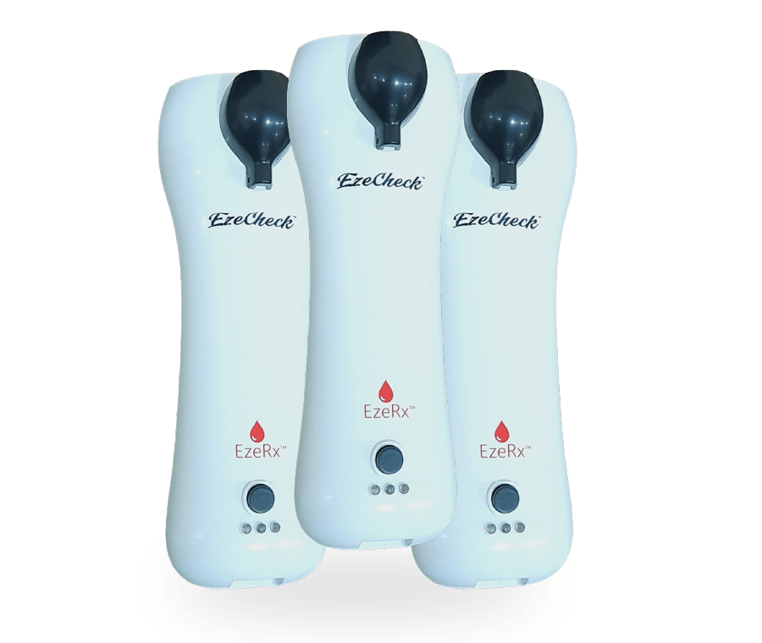
Objectives
To build a prediction model to analyze and predict the level of Haemoglobin concentration from available data on light reflected upon the incidence of light at different frequencies using a proprietary device by EzeRx
To understand the use and importance of Principal Component Analysis to optimize the factors and prediction accuracy of thus following models.
To test the accuracy of thus obtained predictions against traditional blood collection computations of Haemoglobin
To explore the effect of factors such as Gender and Age in the improvement of model to fetch results with high accuracy

Slide 5
Project Flow
Raw Data and EDA
Dimension Reduction
Model Fitting
Model Accuracy and Results
Data Cleaning, missing value removal and visualization
Applied PCA and compared results to optimize factors studied
Applied Linear Regression, SVM and Random Forest algorithms
Fit the model with best accuracy, applied cross validation and obtained final results

Slide 6
Data and EDA
Data Profile & Visualization

Slide 7
Data Profile
Given Data set of 101765 records consisting of Actual Haemoglobin values computed for 2455 subjects as well as their respective light reflected at 100 different frequencies ranging from 30Hz to 300Hz
Independent variables | Light reflected at different frequencies | s1, s2, ….. s100
 | Age (discrete) | Min: 6 years Max: 95 years
 | Gender (binary) | Male, Female
Dependent Variable | Actual HB values (g/dl) | Min: 4 Max: 17.6 Avg: 11.51

Slide 8
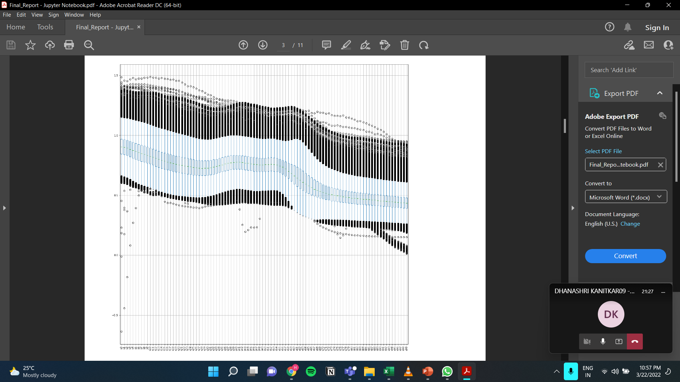
BOX PLOT for Frequency of Light

Slide 9
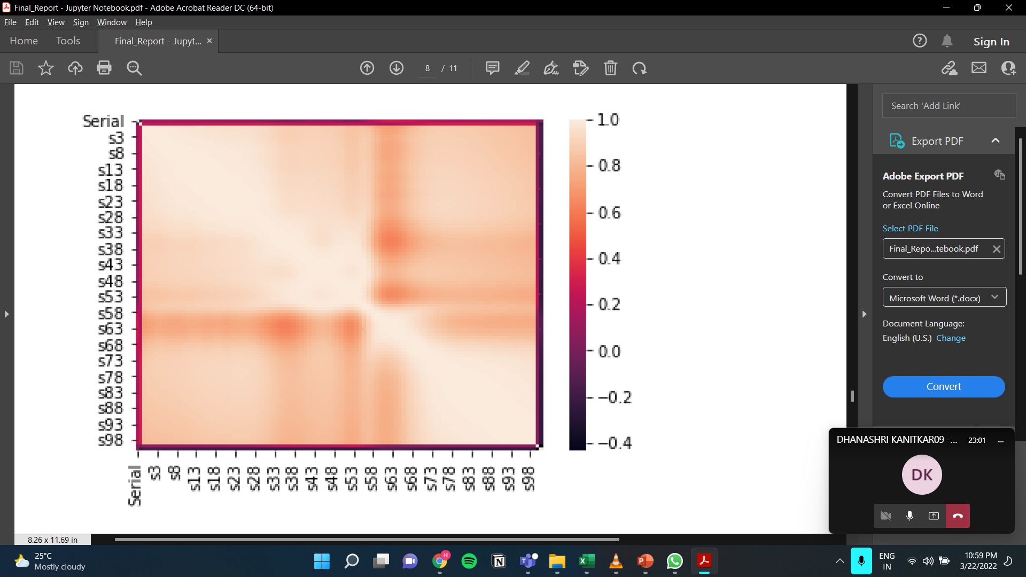
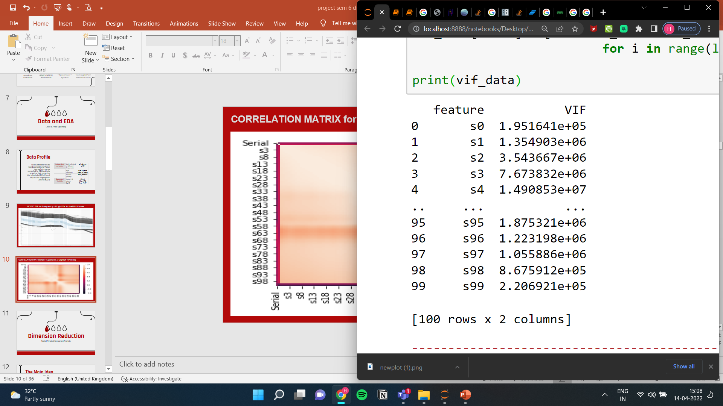
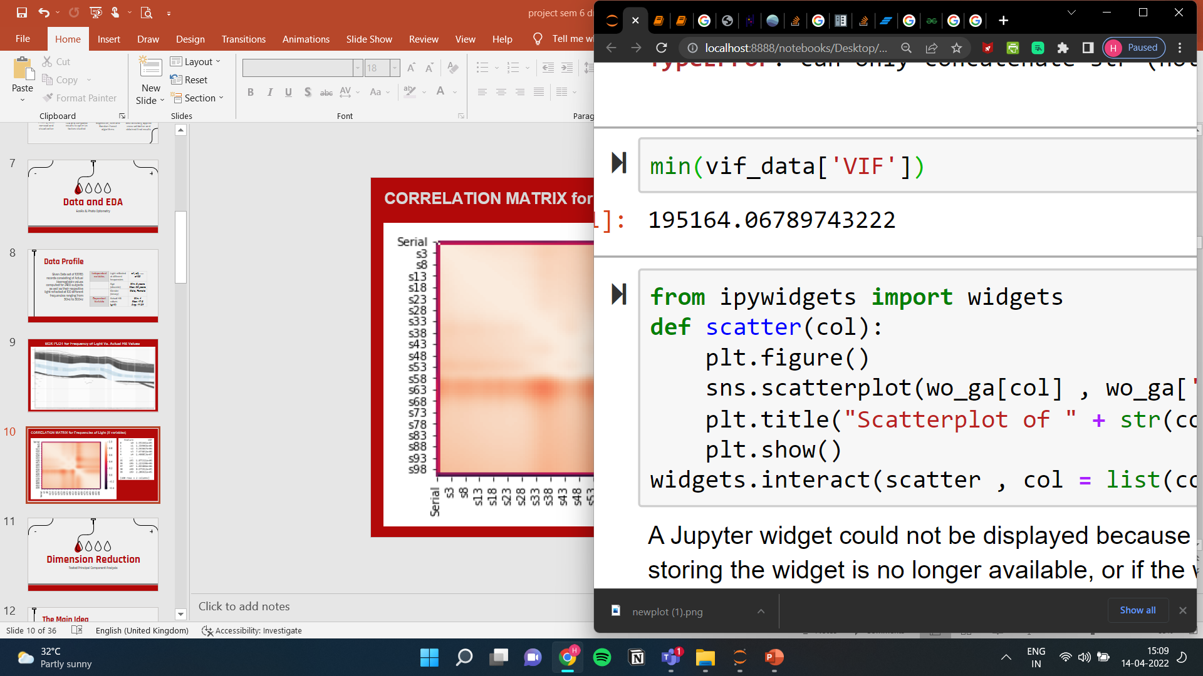
CORRELATION MATRIX for Frequencies of Light (X variables)

Slide 10
Dimension Reduction
Tested Principal Component Analysis

Slide 11
Principal Component Analysis
Handle “curse of dimensionality” + avoid issues like over-fitting in high dimensional space .
PCA - method used to reduce number of variables in your data by extracting important one from a large pool.
Combines highly correlated variables together to form a smaller number of set of variables - “principal components” that account for most variance in the data.
ADVANTAGES:
Principal components are independent of each other, so removes correlated features.
PCA helps in overcoming data overfitting issues by decreasing the number of features.

Slide 12
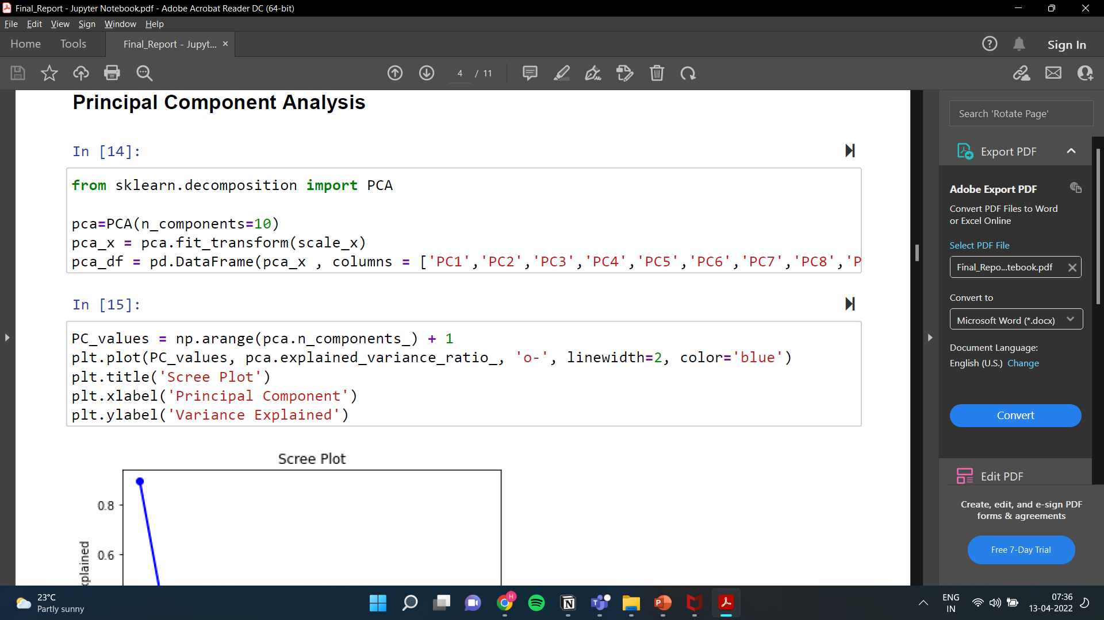
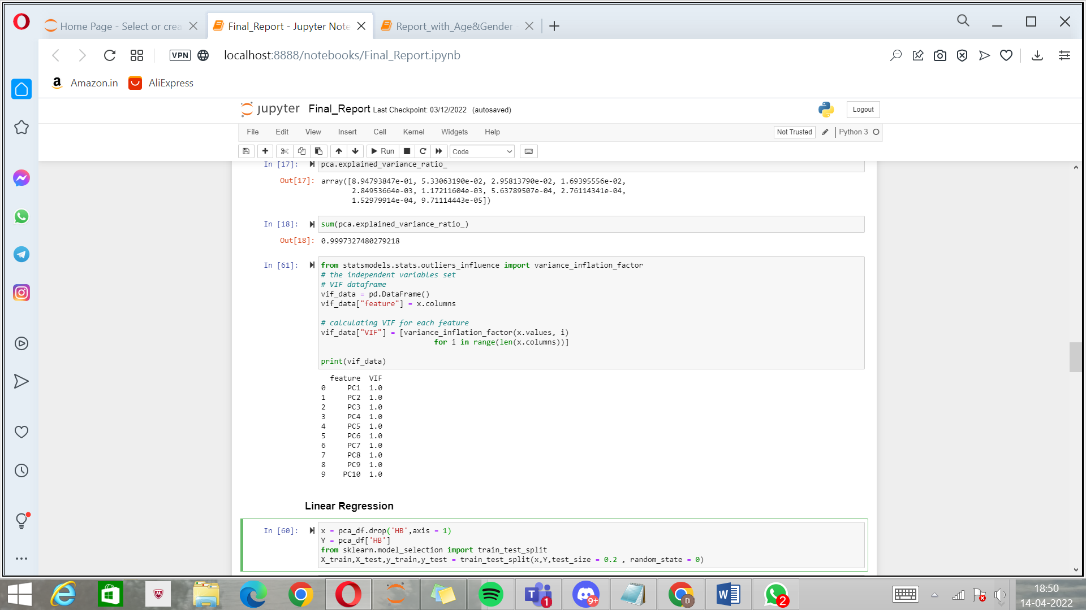
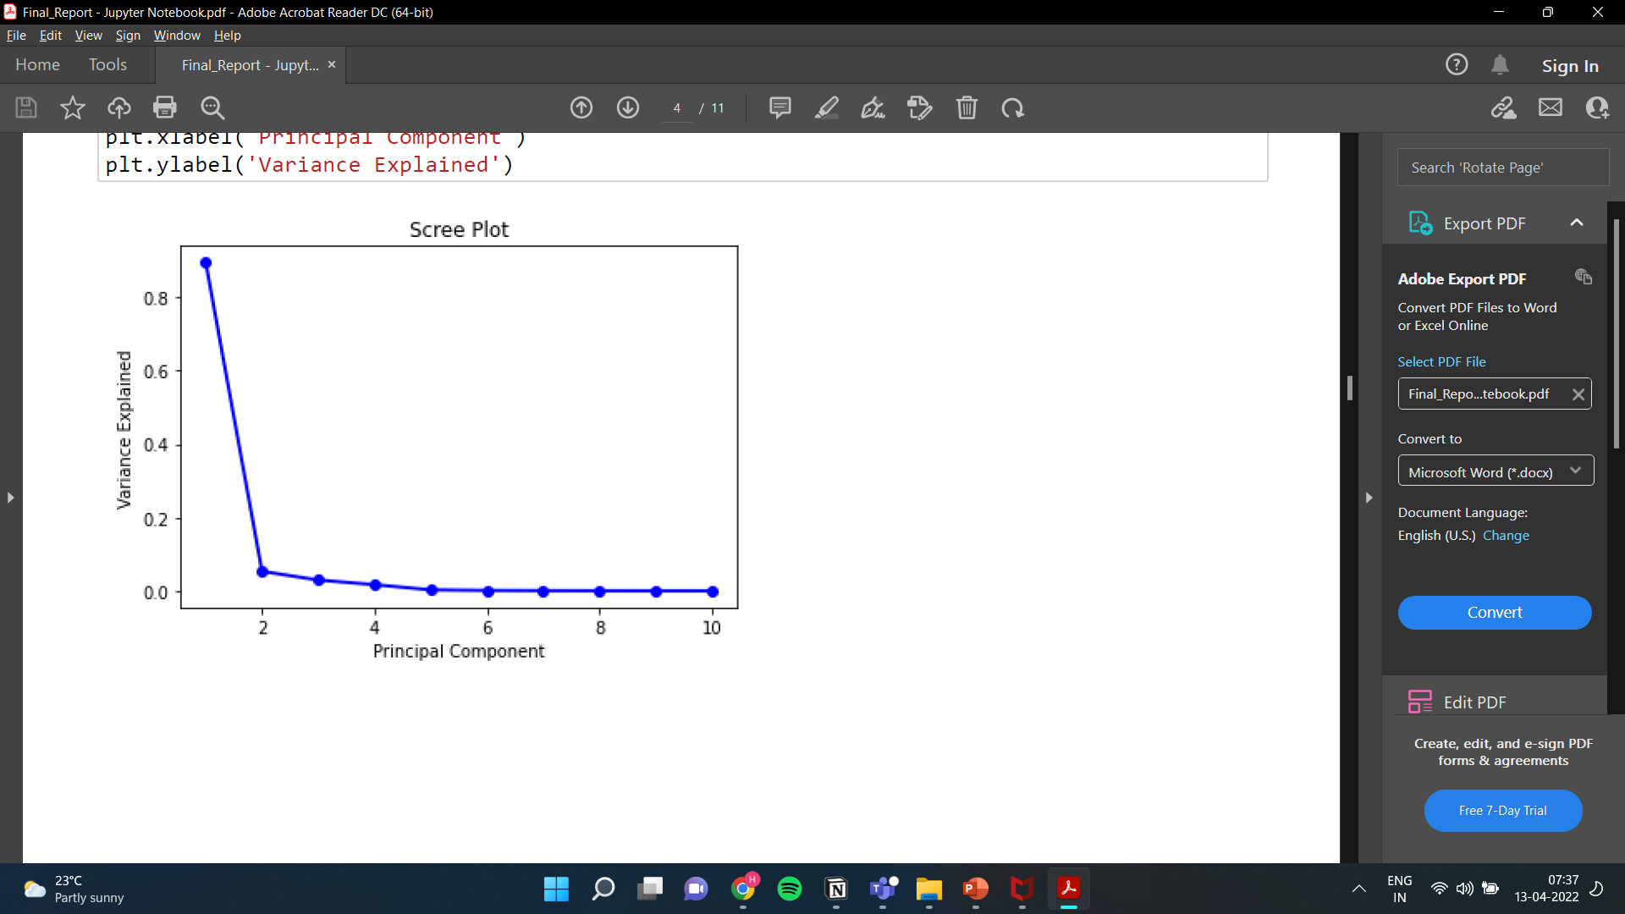
Principal Component Analysis
TOTAL VARIANCE EXPLAINED: 99.97%

Slide 13
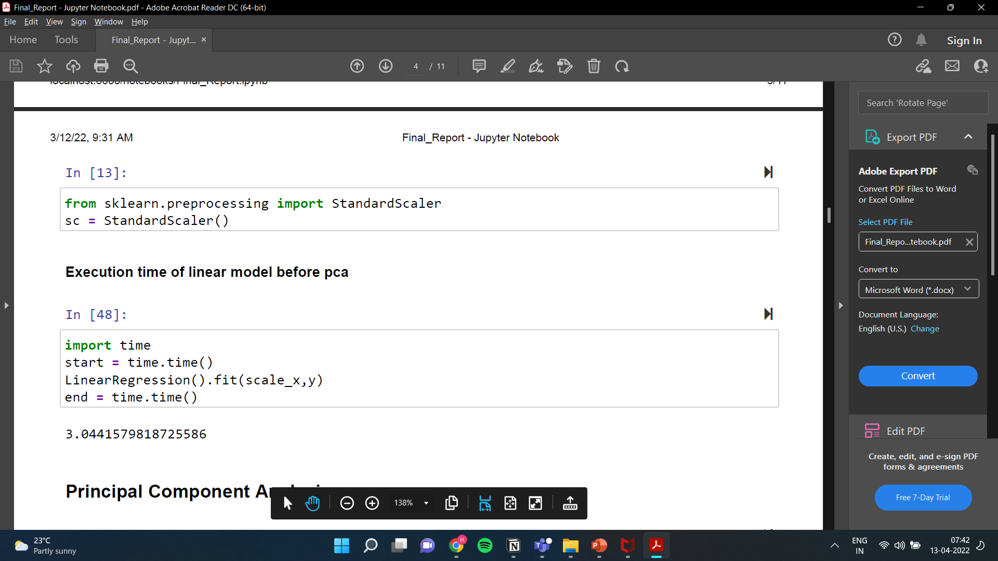
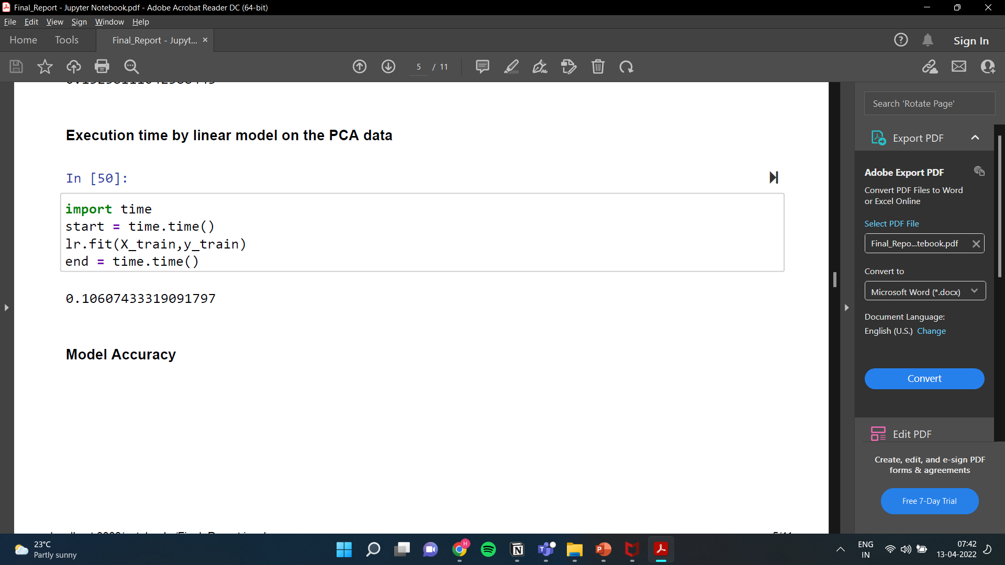
Time Saved by PCA
3.044158
0.106074
Reduction in time by nearly 96.5%

Slide 14
Model Fitting
Used Linear Regression, Random Forest, Support Vector Machines Algorithms

Slide 15
Pre Model Fitting
Scale the Variables
Using StandardScaler()
Principal Component Analysis
Split data into Test and Train datasets
80% train, 20% test
Define X and Y variable(s)
Y: Actual HB, X: PC1 to PC10

Slide 16
Linear Regression
Split data into Test and Train datasets
80% train, 20% test
Obtained R² value of 0.1421 and Adj R² value of 0.1417
Fit Model and Check Goodness of Fit
Use cross validation to verify the model’s accuracy
Obtained max score of 0.1326
HB = 11.51 + (0.0227*PC1) + (0.1836*PC2) + (-0.1424*PC3) + (-0.2829*PC4) + (-0.1626*PC5) + (0.1172*PC6) + (0.1001*PC7) + (0.7588*PC8) + (0.1467*PC9) + (-0.9694*PC10)

Slide 17
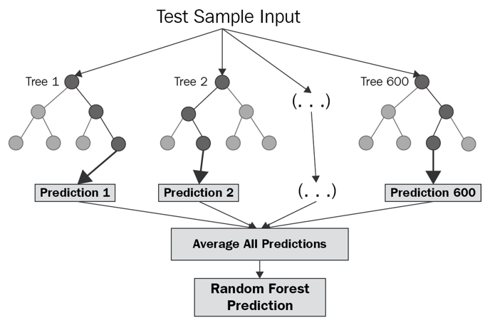
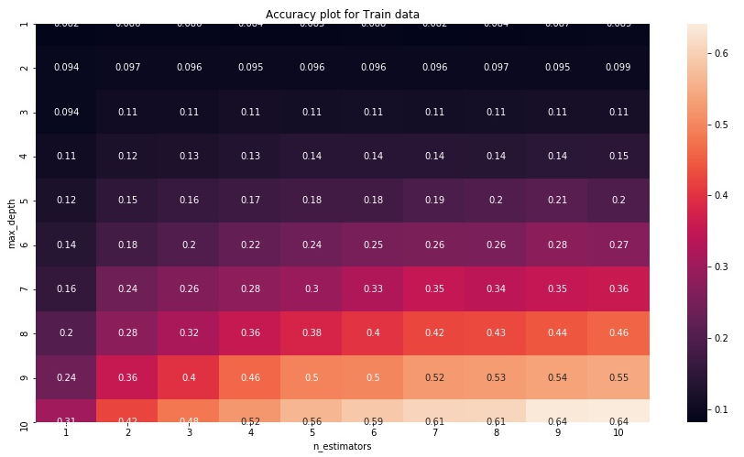
Random Forest

Slide 18
Random Forest
Fit Model using sklearn library
n_estimators = 100, random_state = 0
Check Goodness of Fit
Obtained R² value of 0.957 and Adj R² value of 0.9569
Use cross validation to verify the model’s accuracy
Obtained max score of 0.9508

Slide 19
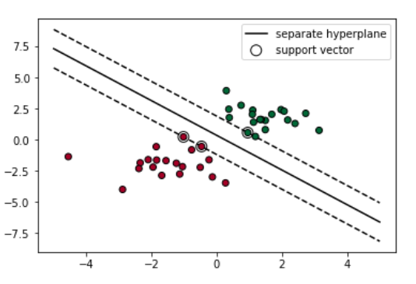
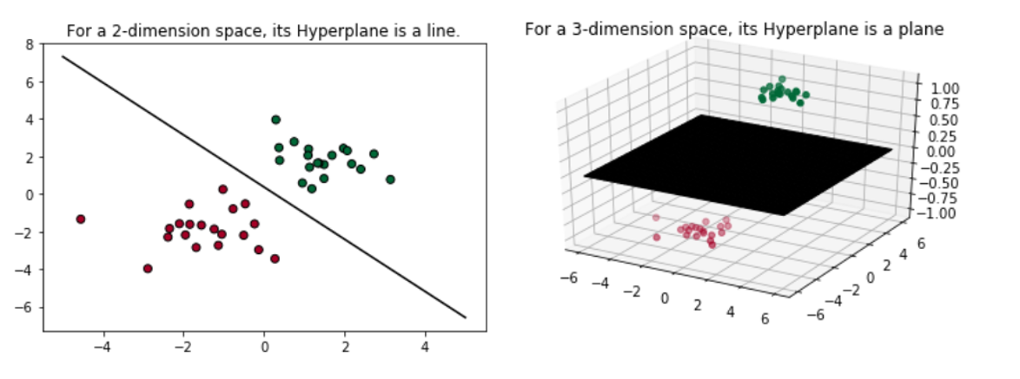
Support Vector Machines
Support Vector Machine is a linear model for classification and regression problems. It can solve linear and non-linear problems and work well for many practical problems.
The idea of SVM is simple: The algorithm creates a line or a hyperplane which separates the data into classes.

Slide 20
Support Vector Machines
Fit Model using sklearn library
kernel = ‘linear’
C = 1
Check Goodness of Fit
Obtained R² value of 0.1250 and Adj R² value of 0.1245
Fit Model with different kernel = polynomial and checked Goodness of fit
Obtained R² value of 0.1167 and Adj R² value of 0.1163

Slide 21
Testing Effect of Age and Gender

Slide 22
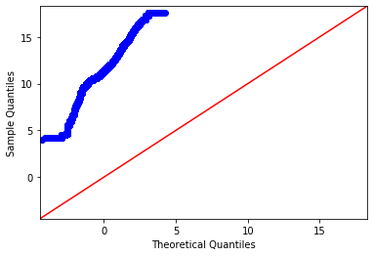
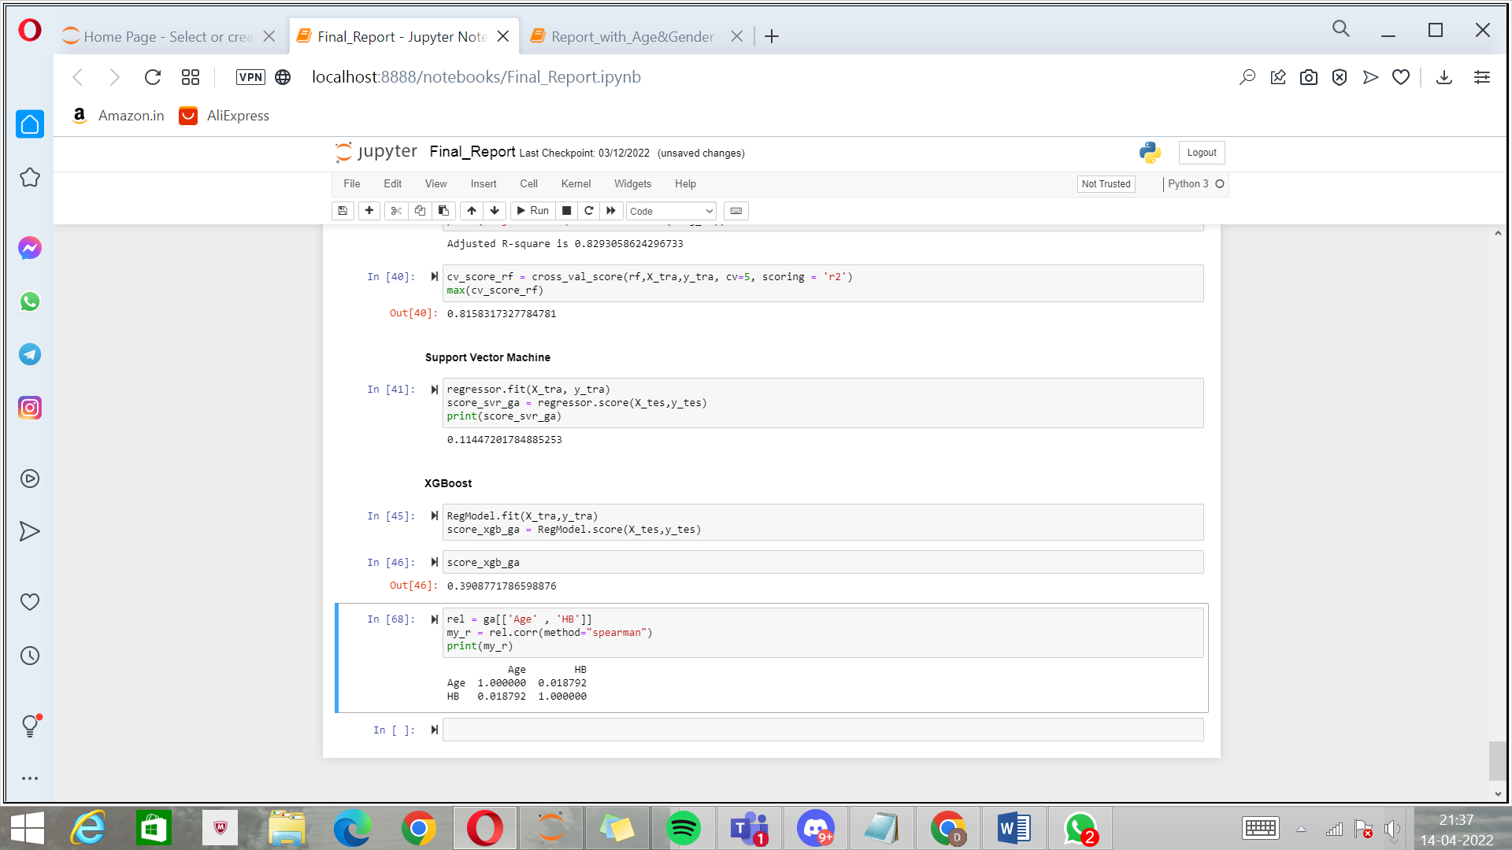
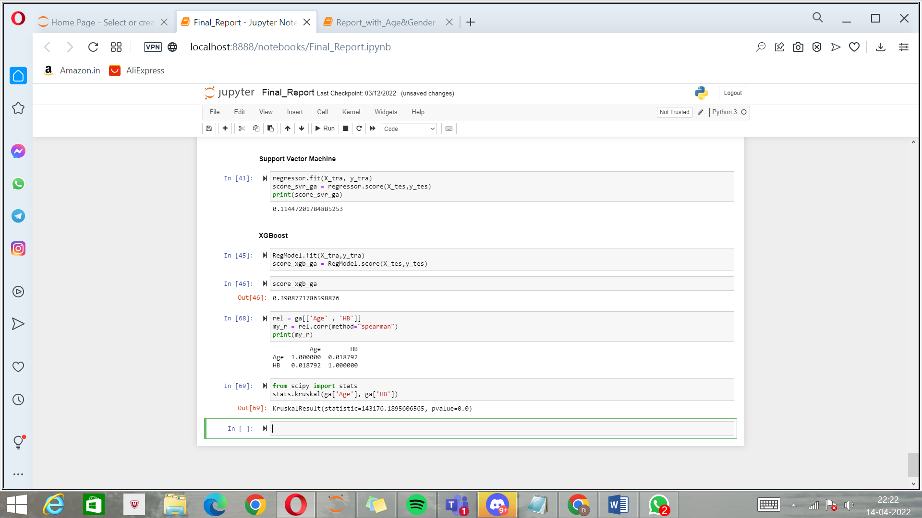
Age
Correlation between Age and HB
Kruskal-Wallis Test of Significance for Age
Notes:
It utilizes ensemble learning, which is a technique that combines many classifiers to provide solutions to complex problems.

Slide 23
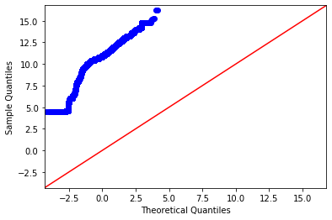
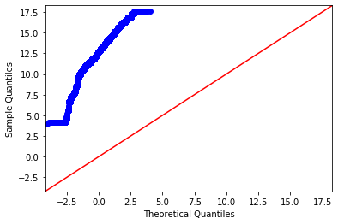
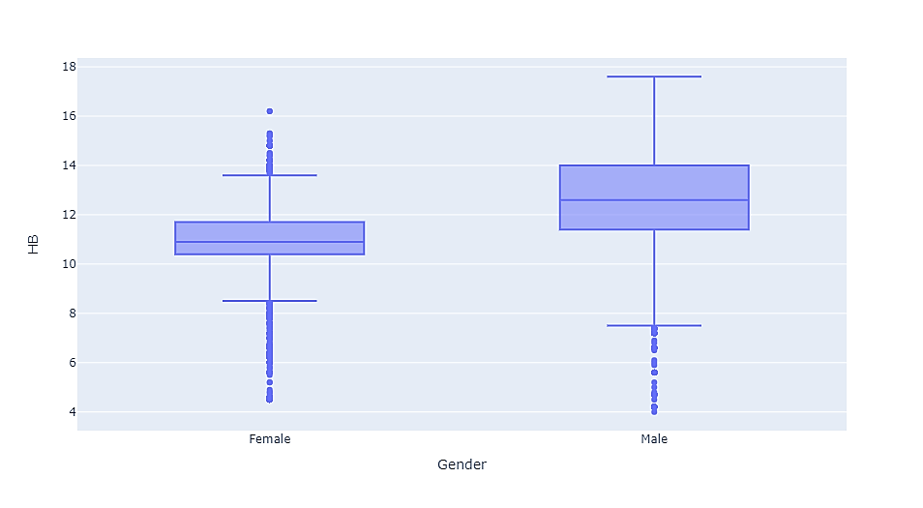
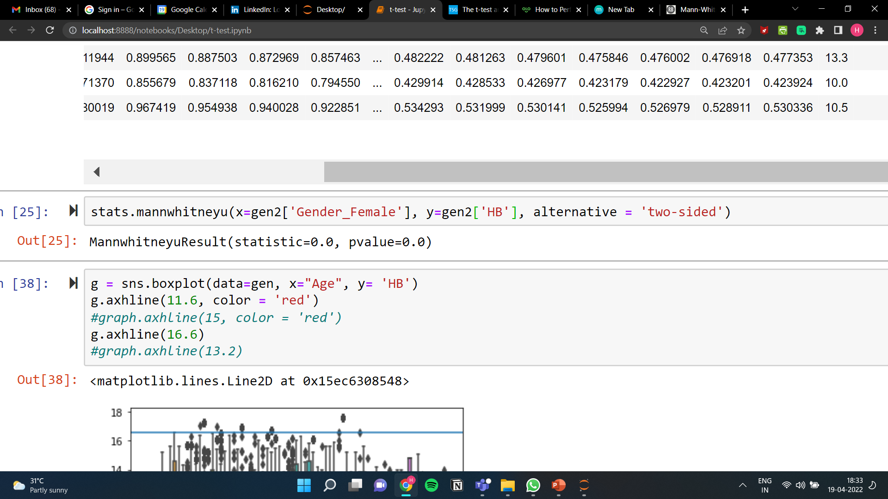
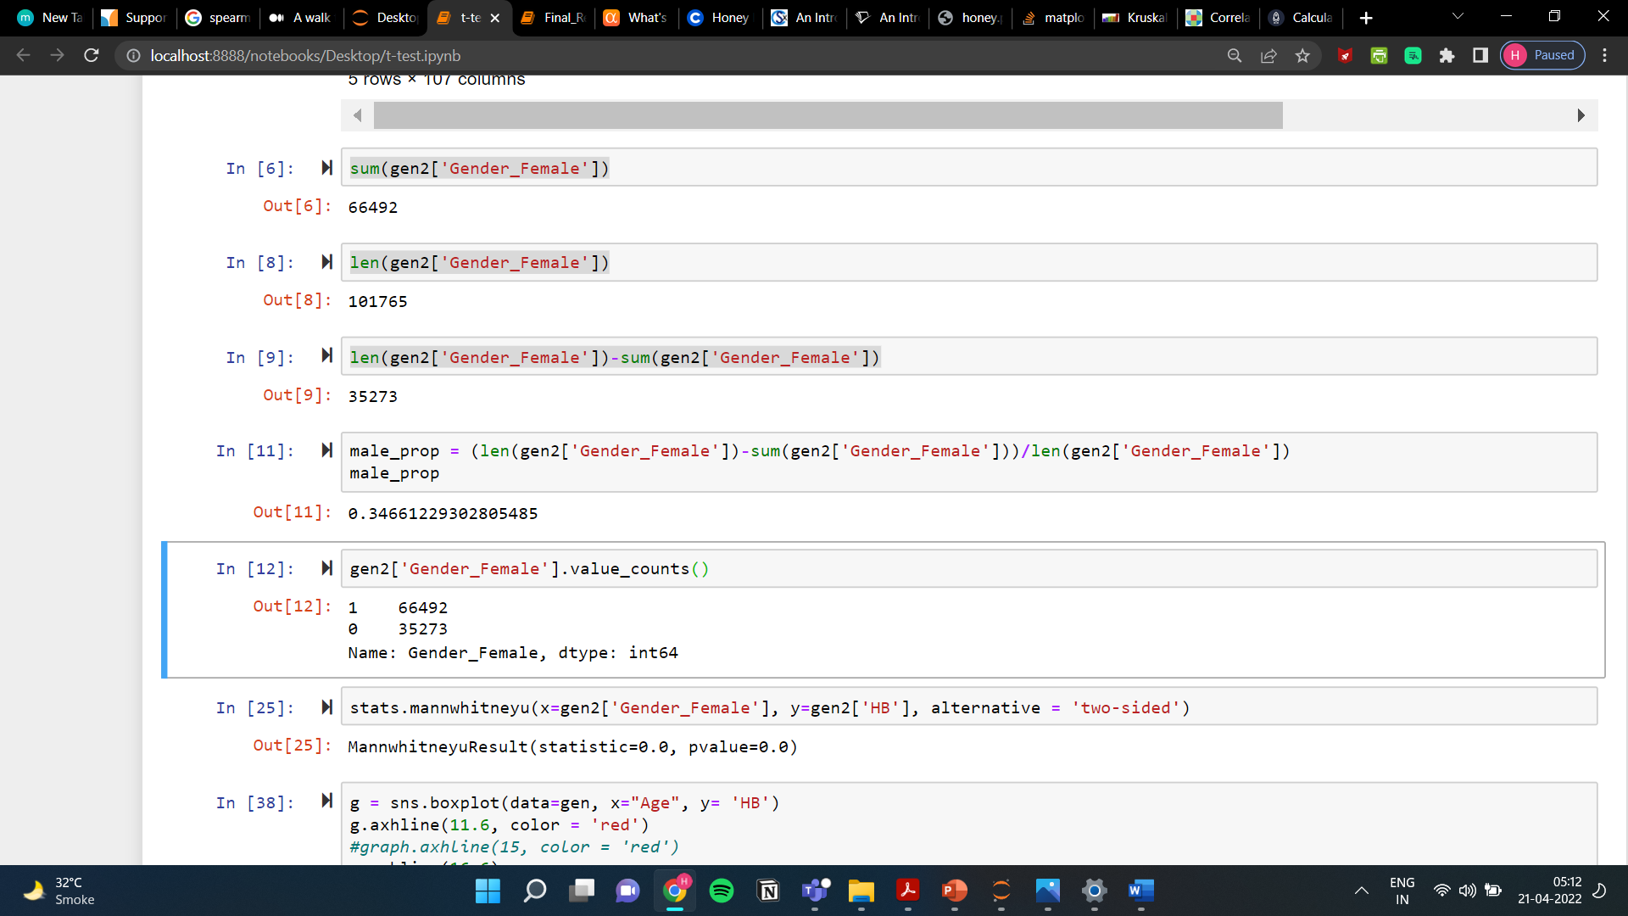
Gender
BOX-PLOT OF GENDER VS. HB
Mann Whitney U Test of Significance for Gender

Slide 24
Comparison of Model Results
Model | Without age and gender | With Age and gender
Linear Regression | 14.17% | 4.169%
Random Forest | 95.69% | 82.93%
SVM (linear) | 12.50% | 3.18%
SVM (polynomial) | 11.67% | 4.36%`

Slide 25
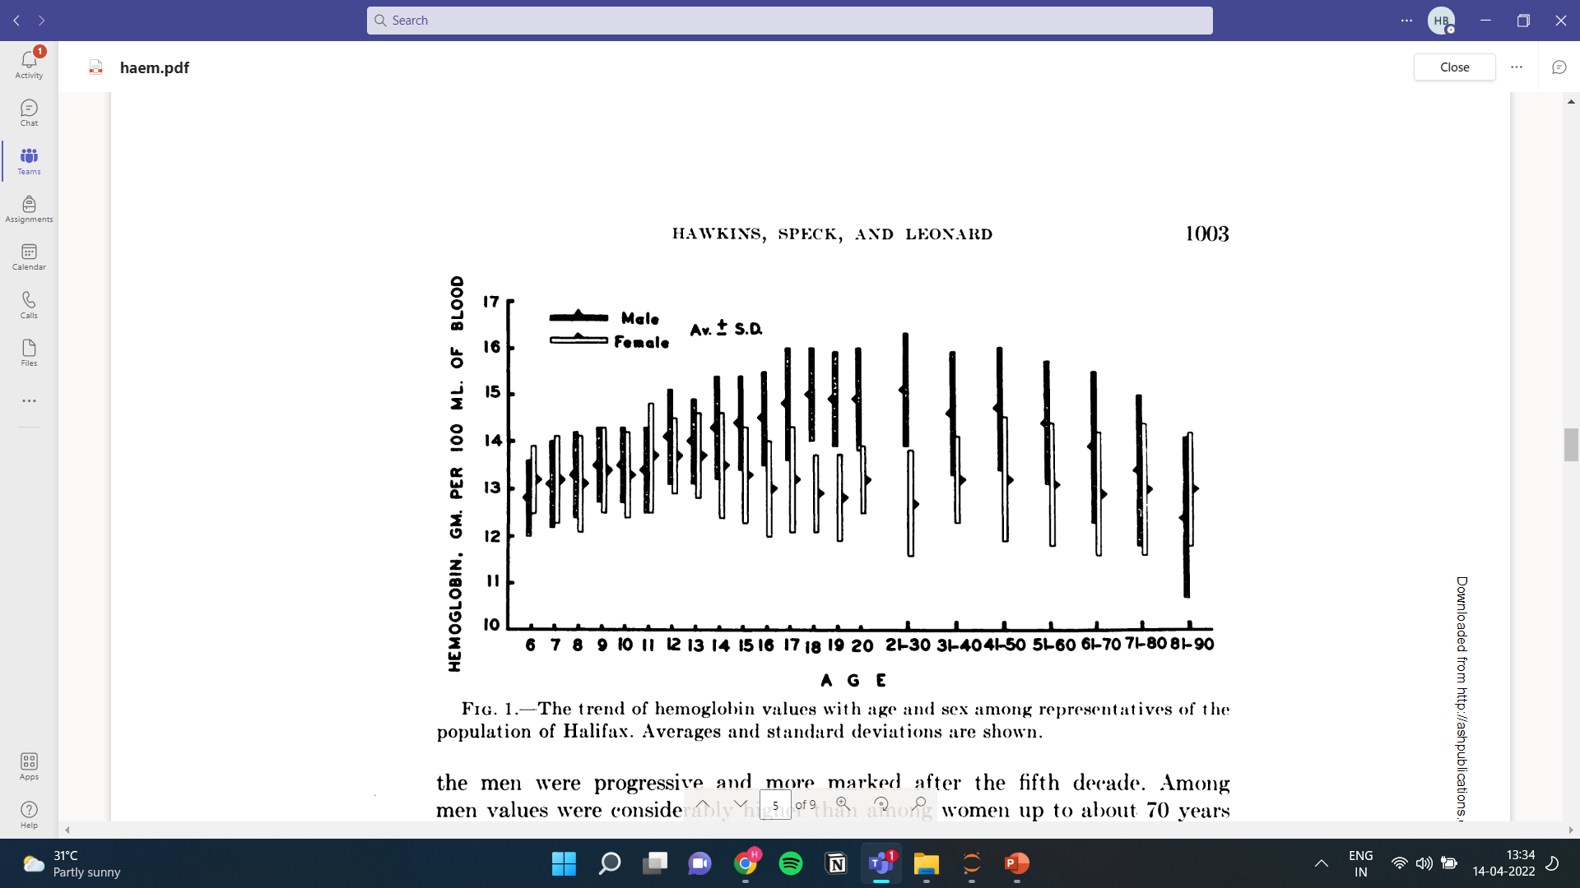
W. W. HAWKINS, EIaLY5 SPECK AND VERNA G. LEONARD [1952-53] “Variation of the Hemoglobin Level with Age and Sex”

Slide 26
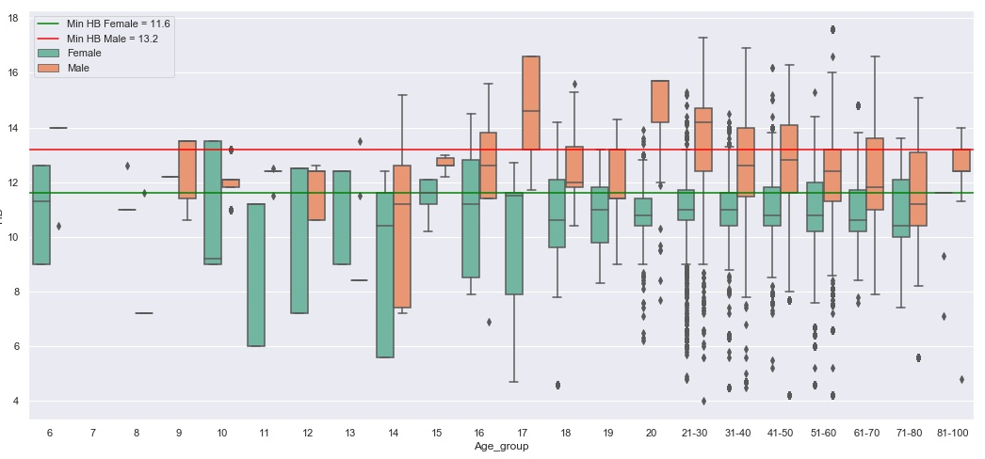
BOX-PLOT for Age and Gender Vs. Actual HB

Slide 27
Conclusions
The Random Forest Algorithm was successful in predicting the Haemoglobin Blood Concentration levels with a prediction accuracy of almost 96% without the inclusion of Age and Gender as predictors.
The use of Principal Component Analysis has been an important step in making the predictor variables of light reflected (at different frequencies) independent principal components therefore removing the multicollinearity present in Xs. Moreover, it greatly improved model efficiency by reducing the computational time in execution.
Although Age and Gender are factors of statistical significance to HB, they negatively impact model accuracy due to the niche sample group from which the data was collected.
Link to code: https://github.com/hbapuram/IDS_EzeRx

Slide 28
FUTURE WORK
The necessary adjustments based on factors [ device dependent variables] need to be investigated before generalising the results. The incandescent light’s properties also present another variable for future exploration.
Limited Haemoglobin Range has been considered which contributed to a skewed data set, hence a broader coverage can be expected to normalise the data leading to uniform results. Patients with blood disorders should also be inclusive.
To enforce proper finger placement and reduce movement, a finger cuff can be designed to centre the finger in the device.
Apart from Hemoglobin (HB) we are trying to model SpO2, BL, CR, RBS, Sugar - FS and PP, HB A1c, Sickle Cell, Urea, Uric Acid, CHOL, TG, HDL, LDL, NA+, K+, CAL, PHOS etc. Looks like sky is the limit...
A research paper is being worked upon keeping in mind the quality of data sets in order to publish the results.

Slide 29
Acknowledgement
We want to thank the team of EzeRx for their help with the coordination and data collection during the clinical study and extending the same to us . This helped us gain insights on new developments in medical avenues.
In particular, We would like to acknowledge and express our gratitude to our Mentor, Prof Sarada Samantaray sir, for not only helping us structure, format and understand the concepts employed in this project, but to also provide us such an enriching experience and a wonderful opportunity to get a sense of the real time data.
We would also like to thank our Introduction to Data Science Professor, Shubham Bhatt for guiding us through the project.
This work is performed under the approval from the NMIMS deemed to be University, Navi Mumbai , School of Science, who provided us with necessary tools and resources.

Slide 30
References
1] Edward Jay Wang , William Li , Doug Hawkins , Terry Gernsheimer , Colette Norby-Slycord , Shwetak N. Patel [2016] “ HemaApp: Noninvasive Blood Screening of Haemoglobin using Smartphone Cameras.” UBICOMP '16, SEPTEMBER 12–16, 2016, HEIDELBERG, GERMANY.
2] W. W. HAWKINS, EIaLY5 SPECK AND VERNA G. LEONARD [1952-53] “Variation of the Hemoglobin Level with Age and Sex”.
3] Bushra Alsunaidi 1 , Murad Althobaiti 1 , Mahbubunnabi Tamal 1 , Waleed Albaker 2 and Ibraheem Al-Naib [2021] “A Review of Non-Invasive Optical Systems for Continuous Blood Glucose Monitoring” Sensors 2021, 21, 6820
4] Caje Pinto, Jivan Parab, Gourish Naik [2020] “Non-invasive hemoglobin measurement using embedded platform” Sensing and Bio-Sensing Research Volume 29, August 2020, 100370
5] Giovanni Dimauro * , Danilo Caivano , Pierangelo Di Pilato, Alessandro Dipalma and Mauro Giuseppe Camporeale [2020] “A Systematic Mapping Study on Research in Anemia Assessment with Non-Invasive Devices” Appl. Sci. 2020, 10, 4804
6] Selim Suner,James Rayner ,Ibrahim U. Ozturan ,Geoffrey Hogan, Caroline P. Meehan ,Alison B. Chambers,Janette Baird, Gregory D. Jay [2021], “Prediction of anaemia and estimation of hemoglobin concentration using a smartphone camera”
7] Joon-myoung Kwon, MD ,Younghoon Cho, MD ,Ki-Hyun Jeon, MD ,Soohyun Cho, MD Kyung-Hee Kim, MD,Seung Don Baek, MD, Soomin Jeung, MD, Jinsik Park, MD, Byung-Hee Oh, MD [2020] “A deep learning algorithm to detect anaemia with ECGs: a retrospective, multicentre study” VOLUME 2, ISSUE 7, E358-E367

Slide 31
THANK YOU!

